Slide 1
Agenda
Equivalence Partitioning
Boundary Analysis
Test Development Process
Test Design Techniques

Slide 2

Test Development Process

Slide 3
Reminder – FTP
Fundamental Test Process
Specification of test cases is part of second step
Three main activities in developing tests
Identify test conditions
Specify test cases
Specify test procedures
Planning and control
Analysis and design
Implementation and execution.
Evaluating exit criteria and reporting
Test closure activities.

Slide 4
Terminology
Test condition
Test case
Test Procedure
an item or event of a component or system that could be verified by one or more test cases, for example a function, transaction, feature, quality attribute or structural element
a set of input values, execution preconditions, expected results and execution postconditions, developed for a particular objective or test condition, such as to exercise a particular program path or to verify compliance with a specific requirement.
a sequence of actions for the execution of a test

Slide 5
Discussion: So, what does all that actually mean?
Test condition
A test condition is some characteristic of our software that we can check with a test or a set of tests
Test case
Preconditions: a test case gets the system to some starting point
Expected Result: applies a set of input values that should achieve a given outcome
Postcondition: leaves the system at some end point.
Test procedure specification
Identifies all the necessary actions in sequence to execute a test (test scripts)
Notes:
A test condition – an item or event of a component or system that could be verified by one or more test cases, for example a function, transaction, feature, quality attribute or structural element. In other words, a test condition is some characteristic of our software that we can check with a test or a set of tests.
A test case – a set of input values, execution preconditions, expected results and execution postconditions, developed for a particular objective or test condition, such as to exercise a particular program path or to verify compliance with a specific requirement. In other words, a test case gets the system to some starting point for the test (execution preconditions); then applies a set of input values that should achieve a given outcome (expected result), and leaves the system at some end point (execution postcondition). Our test design activity will generate the set of input values and we will predict the expected outcome by, for example, identifying from the specification what should happen when those input values are applied. We have to define what state the system is in when we start so that it is ready to receive the inputs and we have to decide what state it is in after the test so that we can check that it ends up in the right place

Slide 6
Designing a test
When designing a test, you should
Decide on your test condition
usually a small section of the software under test
Design a test case that would verify that condition
Write a procedure to execute the test
Starting state, input values, check outcome
Lets analyse an example!

Slide 7
Test Case Design
Sample system specification
1.2.3. - The input screen shall have three fields: a title field with a drop-down selector; a surname field that can accept up to 20 alphabetic characters and the hyphen (-) character; a first name field which can accept up to 20 alphabetic characters. All alphabetic characters shall be case insensitive. All fields must be completed. The data is validated when the Enter key is pressed. If the data is valid the system moves on to the job input screen; if not, an error message is displayed.

Slide 8
Test Conditions
Condition 1
Surname field accepts 20 chars and hyphen
Condition 2
pressing enter moves to job input screen
Condition 3
alphabetic chars are case insensitive

Slide 9
Test Cases
Should be traceable back to the spec: T1.2.3.1
Add specific values to test valid and invalid input
Specify that the system you move to job input screen.
Valid
Invalid
Mr Dennis Ritchie
Mrs Marge1 Simpson
Mrs Grace Hopper
Mr Alan Turing
Mr Apu Nahasapeemapetilon
Mr “Diamond” Joe Quimby

Slide 10
Test procedure
Select the option from the main menu.
Select the ‘input’ option from the menu.
Select ‘Mr’ from the ‘Title’ drop-down menu.
Check that the cursor moves to the ‘surname’ field.
Type in ‘Ritchie’ and press the tab key once; check that the cursor moves to the ‘first name’ field.
Type in ‘Dennis’ and press the Enter key.
Check that the Job Input screen is displayed.
. . .
Notes:
The test procedure would collect together all the test cases related to this specification element so that they can all be executed together as a block; there would be several to test valid and non-valid inputs, as you have seen in the example.

Slide 11
Next Steps
In wider FTP process – move to test execution
In preparation for test execution – the test schedule may gather together all the tests and sequences them
Takes into account priorities and dependencies
Example:
Do all tests on input screen together
Then to all that use input data
May be required to run some tests before others
E.g. passwords
Need to log in to run other tests
Notes:
In the wider process (the FTP) we would move on to the test execution step next. In preparation for execution the test execution schedule collects together all the tests and sequences them, taking into account any priorities (highest priority tests would be run first) and any dependencies between tests. For example, it would make sense to do all the tests on the input screen together and to do all the tests that use input data afterwards; that way we get the input screen tests to do the data entry that we will need for the later tests. There might also be technical reasons why we run tests in a particular sequence; for example, a test of the password security needs to be done at the beginning of a sequence of tests because we need to be able to get into the system to run the other tests

Slide 12
What is Test Coverage
Is a metric in Software testing that measures the amount of testing performed.
Provides a quantitive assessment of the extent and quality of testing
Tries to answer the question: how much testing have you done?

Slide 13
Test coverage - meaning
Test coverage can have different meaning in different contexts
Product Coverage
Which areas of product have your focused on and which remains untested?
Risk coverage
Can a product be considered ‘tested’ without testing associated risks?
Requirements coverage
How well does the product meet customer requirements?
Notes:
Product Coverage:
Example #1:
If “knife” is a product, you are testing; just do not concentrate on checking whether it cuts the vegetables/fruits properly. There are other aspects to look for such as – the user should be able to handle it comfortably.
Example #2:
If “notepad” is an application, you are testing, checking relevant features is a must thing.
But other aspects to be taken care are – application responds properly while using other applications simultaneously, the application does not crash when the user tries to do something unusual, the user is provided proper warning/error messages, the user is able to understand and use the application easily, help content is available when required.
Risk Coverage
Example #1:
While testing an airplane, if a tester tells you that he/she has fully tested the internal system of the airplane and it’s working fine but only flying capability of the airplane was not covered while testing – what would be your reaction?
Well, that is what risk coverage means. Identifying risk as per the application/product and testing it thoroughly is always a good practice.
Example #2:
While testing an e-commerce site, tester considered every effective factor but did not consider the risk of numbers of users accessing the website simultaneously and on the Super OFFER day, the not considered risk proved to be a huge mistake.
Requirements Coverage
Example #1:
Excited for the family function, you asked the tailor to stitch your dress and put on those peacock blue show buttons on the neckline.
While stitching the dress, tailor thought that putting those buttons on neckline will not look good so he stitched a golden colored border instead. On the trial day, definitely, the unhappy customer shouted at the tailor for not sticking to the requirements.
Example #2 :
While testing a chat application, tester took care of all the important points like multiple users chatting in a group, two users chatting independently, all types of emoticons available, updates sent to user immediately etc. but forgot to look into requirement document, which clearly mentioned that when two users chat independently, video call option should be enabled.

Slide 14
Discussion: Test coverage
Consider the following statements regarding test coverage:
I’m nearly done
I’ve done two weeks of testing
I’ve done everything in the test plan
What do they tell you about how much testing have been done(coverage)?
Do they tell you:
How effective the testing has been?
What has been achieved?
Notes:
A test condition – an item or event of a component or system that could be verified by one or more test cases, for example a function, transaction, feature, quality attribute or structural element. In other words, a test condition is some characteristic of our software that we can check with a test or a set of tests.
A test case – a set of input values, execution preconditions, expected results and execution postconditions, developed for a particular objective or test condition, such as to exercise a particular program path or to verify compliance with a specific requirement. In other words, a test case: gets the system to some starting point for the test (execution preconditions); then applies a set of input values that should achieve a given outcome (expected result), and leaves the system at some end point (execution postcondition). Our test design activity will generate the set of input values and we will predict the expected outcome by, for example, identifying from the specification what should happen when those input values are applied. We have to define what state the system is in when we start so that it is ready to receive the inputs and we have to decide what state it is in after the test so that we can check that it ends up in the right place

Slide 15
Why test coverage does?
Why do we need to know about test coverage?
It provides a quantitative measure of the quality of the testing that has been done by measuring what has been achieved.
It provides a way of estimating how much more testing needs to be done.
Using quantitative measures, we can set targets for test coverage and measure progress against them
Now consider the following statements:
I have tested 75% of requirements
I have tested 60% of decisions

Slide 16
Benefits of test coverage
It can assure the quality of the test
It can help identify what portions of the code were actually touched for the release or fix
It can help to determine the paths in your application that were not tested
Time, scope and cost can be kept under control
Gaps in requirements, test cases and defects at the unit level and code level can be found in an easy way

Slide 17
Test design techniques

Slide 18
Categories of Test Case Design Techniques
While there are many techniques, three of the broad categories are:
Specification based (Black Box techniques)
Structure based (white box techniques)
Experience based
Notes:
Specification:
based on deriving test cases directly from a specification or a model of a system or proposed system, known as specification-based or black-box techniques. So black-box techniques are based on an analysis of the test basis documentation, including both functional and non-functional aspects. They do not use any information regarding the internal structure of the component or system under test.
Structure based:
Those based on deriving test cases directly from the structure of a component or system, known as structure-based, structural or white-box techniques. We will concentrate on tests based on the code written to implement a component or system in this chapter, but other aspects of structure, such as a menu structure, can be tested in a similar way.
Experience based:
Those based on deriving test cases from the tester’s experience of similar systems and general experience of testing, known as experience-based techniques.

Slide 19
Specification Based (Black Box) Techniques
Test cases are derived directly from the system specification or model.
i.e. tests based on what the system should do
Important note:
The Spec/Model should not define how a system should achieve the specified behaviour.
It is a specification of the required behaviour
It is therefore important to ensure there is a separate of
the definition of what a system should do
from how it should how
This allows developers and testers to work independentently so that it can be checked if they will arrive at the same place.
Notes:
The most important point about specification-based techniques is that specifications or models do not (and should not) define how a system should achieve the specified behaviour when it is built; it is a specification of the required (or at least desired) behaviour. One of the hard lessons that software engineers have learned from experience is that it is important to separate the definition of what a system should do (a specification) from the definition of how it should work (a design). This separation allows the two specialist groups (testers for specifications and designers for design) to work independently so that we can later check that they have arrived at the same place, that is they have together built a system and tested that it works according to its specification.

Slide 20
Types Of Black Box Testing
Black box testing can be applied to three main types of tests: functional, non-functional, and regression testing.
Functional Testing
Black box testing can test specific functions or features of the software under test. For example, checking that it is possible to log in using correct user credentials, and not possible to log in using wrong credentials.
Functional testing can focus on the most critical aspects of the software (smoke testing/sanity testing), on integration between key components (integration testing), or on the system as a whole (system testing).

Slide 21
Non-Functional Testing
Black box testing can check additional aspects of the software, beyond features and functionality. A non-functional test does not check “if” the software can perform a specific action but “how” it performs that action.
Black box tests can uncover if software is:
Usable and easy to understand for its users
Performant under expected or peak loads
Compatible with relevant devices, screen sizes, browsers or operating systems
Exposed to security vulnerabilities or common security threats
Regression Testing
Black box testing can be used to check if a new version of the software exhibits a regression, or degradation in capabilities, from one version to the next. Regression testing can be applied to functional aspects of the software (for example, a specific feature no longer works as expected in the new version), or non-functional aspects (for example, an operation that performed well is very slow in the new version).

Slide 22

Specification Based (Black Box) Techniques
There are 5 black box testing techniques
Equivalence partitioning
Boundary Value Analysis
Decision table testing
State transition
Use case testing
Notes:
The most important point about specification-based techniques is that specifications or models do not (and should not) define how a system should achieve the specified behaviour when it is built; it is a specification of the required (or at least desired) behaviour. One of the hard lessons that software engineers have learned from experience is that it is important to separate the definition of what a system should do (a specification) from the definition of how it should work (a design). This separation allows the two specialist groups (testers for specifications and designers for design) to work independently so that we can later check that they have arrived at the same place, that is they have together built a system and tested that it works according to its specification.

Slide 23
Equivalence Partitioning
It is the idea that in many cases, inputs can be ‘chunked’ into groups.
Example:
Each is known as an equivalence partition.
every value inside the partition is exactly equivalent to any other value as far as the program is concerned.
Specification
Partitions
Less than zero
The program separates numbers into groups according to whether they are positive or negative
A program accepts any integer value between -10,000 and 10,000
Zero
More than zero
Notes:
The most important point about specification-based techniques is that specifications or models do not (and should not) define how a system should achieve the specified behaviour when it is built; it is a specification of the required (or at least desired) behaviour. One of the hard lessons that software engineers have learned from experience is that it is important to separate the definition of what a system should do (a specification) from the definition of how it should work (a design). This separation allows the two specialist groups (testers for specifications and designers for design) to work independently so that we can later check that they have arrived at the same place, that is they have together built a system and tested that it works according to its specification.

Slide 24
Why Equivalence Partitioning
Reduces number of test cases
Reduces time required for testing
Divides input data into different equivalence classes
Usually applied where there is a range in an input field.
Notes:
The most important point about specification-based techniques is that specifications or models do not (and should not) define how a system should achieve the specified behaviour when it is built; it is a specification of the required (or at least desired) behaviour. One of the hard lessons that software engineers have learned from experience is that it is important to separate the definition of what a system should do (a specification) from the definition of how it should work (a design). This separation allows the two specialist groups (testers for specifications and designers for design) to work independently so that we can later check that they have arrived at the same place, that is they have together built a system and tested that it works according to its specification.

Slide 25
Equivalence Partitioning
For every conditions:
Tests with valid and invalid values
Note: can be useful to represent as a table.
Or for a specific case
Condition | Valid Equivalence Classes | Invalid Equivalence Classes
Invalid | Valid | Invalid | invalid
Invalid value | Valid value | Invalid value | Invalid value

Slide 26
How to form Equivalence classes
Depends on the variable type/domain
For an interval/range
one valid case (inside), two invalid ones (on both sides)
For fixed (specified) number
one valid case, two invalid cases (larger, smaller)
For enumeration/list type
each value, plus an invalid one

Slide 27
Equivalence Partitioning – Example 1
Consider an example:
Text box with input range from 100 to 999
Condition | Valid Equivalence Classes | Invalid Equivalence Classes
Value entered | Value entered is 100 to 999 inclusive | Less than 100 More than 999 Real numbers Non numeric characters
Invalid | Valid | Invalid | Invalid | Invalid
<100 | 100 999 | >999 | Real numbers | Non-numeric chars

Slide 28

Boundary Value analysis
Refines equivalence class partitioning in two ways
Each limit of an equivalence class is covered by a test
E.g. values above and below limits
Derive tests from domain output values, not only input.

Slide 29
Boundary Value analysis
It is known that programmers tend to make errors that cluster around boundaries.
Example:
If a program accepts values between 1 and 100
The most likely fault are values that lie just outside this range are incorrectly accepted or values just inside are incorrectly rejected.
Usually identifies three values at each boundary
In the above example, the values would be 0, 1, 2 and 99, 100, 101

Slide 30
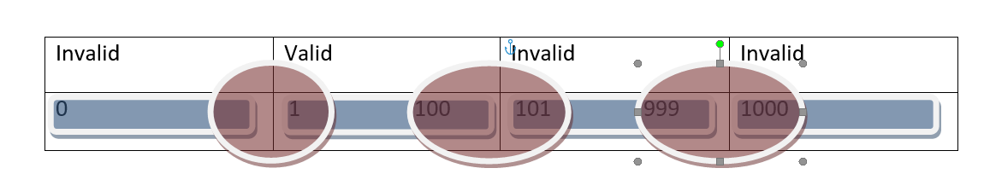
Boundary Value analysis example
A marks input form includes an integer field that should contain values between 1 and 100.
Condition | Valid Equivalence Classes | Invalid Equivalence Classes
Value entered | between 1 and 100 inclusive | Zero Less than 1 Greater than 100 Numbers with 4 chars
Boundary Values:
0, 1, 2
99,100,101
999, 1000, 1001

Slide 31
Lets go through a sample exercise

Slide 32
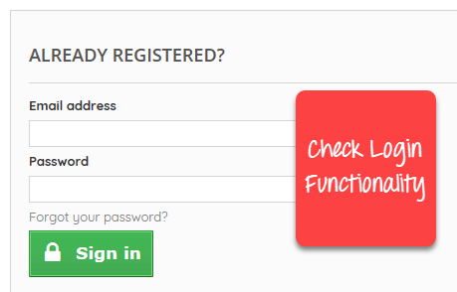
Steps to Create Test Cases in Manual Testing
Let’s create a Test Case for the scenario: Check Login Functionality

Slide 33
What is Test Data in Software Testing?
Test Data in Software Testing is the input given to a software program during test execution. It represents data that affects or affected by software execution while testing. Test data is used for both positive testing to verify that functions produce expected results for given inputs and for negative testing to test software ability to handle unusual, exceptional or unexpected inputs.
Poorly designed testing data may not test all possible test scenarios which will hamper the quality of the software.

Slide 34
Step 1) A simple test case to explain the scenario would be
Test Case # | Test Case Description
1 | Check response when valid email and password is entered
Step 2) Test the Data. In order to execute the test case, you would need Test Data. Adding it below
Identifying test data can be time-consuming and may sometimes require creating test data afresh. The reason it needs to be documented.
Test Case # | Test Case Description | Test Data
1 | Check response when valid email and password is entered | Email: guru99@email.com Password: lNf9^Oti7^2h

Slide 35
Step 3) Perform actions.
In order to execute a test case, a tester needs to perform a specific set of actions on the AUT. This is documented as below:
Test Case # | Test Case Description | Test Steps | Test Data
1 | Check response when valid email and password is entered | 1) Enter Email Address 2) Enter Password 3) Click Sign in | Email: guru99@email.com Password: lNf9^Oti7^2h
Many times the Test Steps are not simple as above, hence they need documentation. Also, the author of the test case may leave the organization or go on a vacation or is sick and off duty or is very busy with other critical tasks. A recently hire may be asked to execute the test case. Documented steps will help him and also facilitate reviews by other stakeholders.

Slide 36
Step 4) Check behavior of the AUT. The goal of test cases in software testing is to check behavior of the AUT for an expected result. This needs to be documented as below
Test Case # | Test Case Description | Test Data | Expected Result
1 | Check response when valid email and password is entered | Email: guru99@email.com Password: lNf9^Oti7^2h | Login should be successful
During test execution time, the tester will check expected results against actual results and assign a pass or fail status

Slide 37
Test Case # | Test Case Description | Test Data | Expected Result | Actual Result | Pass/Fail
1 | Check response when valid email and password is entered | Email: guru99@email.com Password: lNf9^Oti7^2h | Login should be successful | Login was successful | Pass
Step 5) That apart your test case -may have a field like, Pre – Condition which specifies things that must be in place before the test can run. For our test case, a pre-condition would be to have a browser installed to have access to the site under test. A test case may also include Post – Conditions which specifies anything that applies after the test case completes. For our test case, a postcondition would be time & date of login is stored in the database

Slide 38
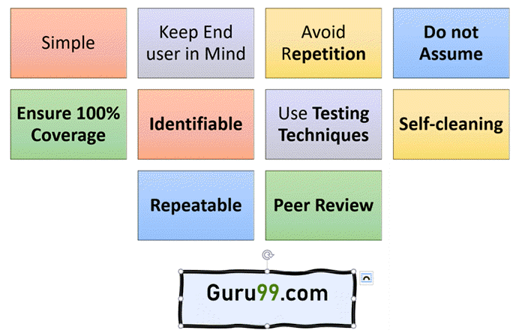
Best Practice for writing good Test Case.

Slide 39
Implement Testing Techniques
It’s not possible to check every possible condition in your software application. Software Testing techniques help you select a few test cases with the maximum possibility of finding a defect.
Boundary Value Analysis (BVA): As the name suggests it’s the technique that defines the testing of boundaries for a specified range of values.
Equivalence Partition (EP): This technique partitions the range into equal parts/groups that tend to have the same behavior.
State Transition Technique: This method is used when software behavior changes from one state to another following particular action.
Error Guessing Technique: This is guessing/anticipating the error that may arise while doing manual testing. This is not a formal method and takes advantages of a tester’s experience with the application

Slide 40
While drafting a test case to include the following information
The description of what requirement is being tested
The explanation of how the system will be tested
The test setup like a version of an application under test, software, data files, operating system, hardware, security access, physical or logical date, time of day, prerequisites such as other tests and any other setup information pertinent to the requirements being tested
Inputs and outputs or actions and expected results
Any proofs or attachments
Use active case language
Test Case should not be more than 15 steps
An automated test script is commented with inputs, purpose and expected results
The setup offers an alternative to pre-requisite tests
With other tests, it should be an incorrect business scenario order

Slide 41
The format of Standard Test Cases
Below is a format of a standard login Test cases example.
Test Case ID | Test Case Description | Test Steps | Test Data | Expected Results | Actual Results | Pass/Fail
TU01 | Check Customer Login with valid Data | Go to site http://demo.guru99.com Enter UserId Enter Password Click Submit | Userid = guru99 Password = pass99 | User should Login into an application | As Expected | Pass
TU02 | Check Customer Login with invalid Data | Go to site http://demo.guru99.com Enter UserId Enter Password Click Submit | Userid = guru99 Password = glass99 | User should not Login into an application | As Expected | Pass
This entire table may be created in Word, Excel or any other Test management tool. That’s all to Test Case Design

Slide 42
Requirements Analysis

Slide 43
Problem Reporting

Slide 44
Documentation Techniques

Slide 46
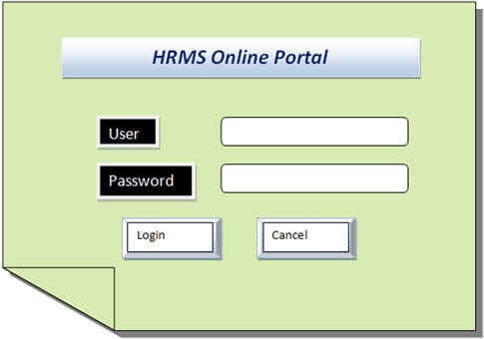
Discussion: Function testing use case
What is the best testing approach?
Specifications
User Id field:
Characters – min 6, max 10
Numbers (0-9) and letters (a-z, A-Z)
Special chars (_ , . , - ,)
Cannot be blank
Password field
Characters – min 6, max 10
Numbers (0-9) and letters (a-z, A-Z)
Special chars(all)

Slide 47
Discussion: Non-functional testing
Example Use Case:
Consider the Facebook login page, what are the non-functional aspects that could be tested?
Sample questions to ask
How does the application perform under normal circumstances?
How does the application behave when too many users login concurrently?
Can the application handle stress?
How secure is the application?
Can the application recover from any disaster?
How easy is to port the application in a different system?

Slide 48
Psychology of testing

